Slide 1
Developing Heterogeneous Embedded Systems
Embedded Systems are really, really, really, difficult
Ian Gray
Real-Time Systems Group, Department of Computer Science, University of York, UK

Slide 2
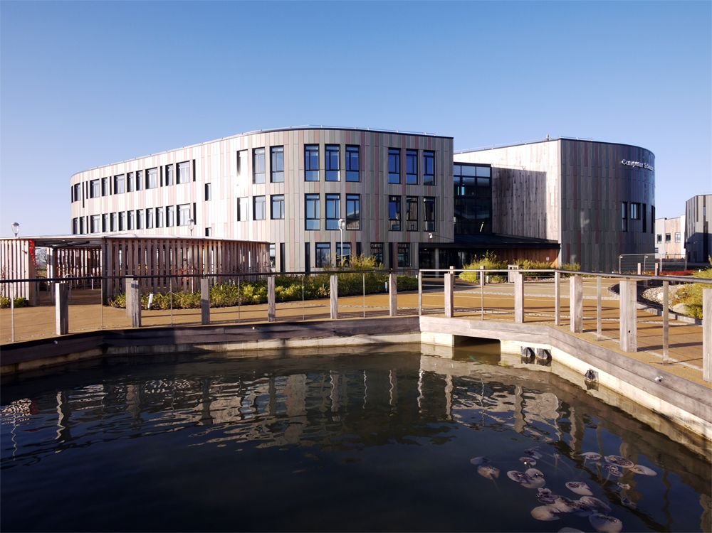
York Computer Science

Slide 3
York Computer Science

Slide 4
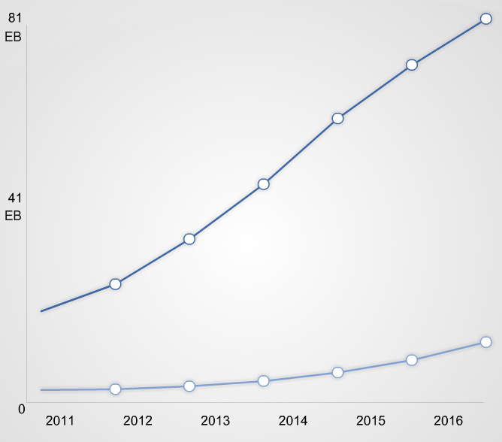
Embedded architectures
Clock speed of processor cores (Hz)
Global internet traffic
IP
Mobile
Data from Intel, assembled by Colin Gillespie
Cisco VNI June 2012
Notes:
By 2016, total traffic will be 4x what it was in 2011

Slide 5
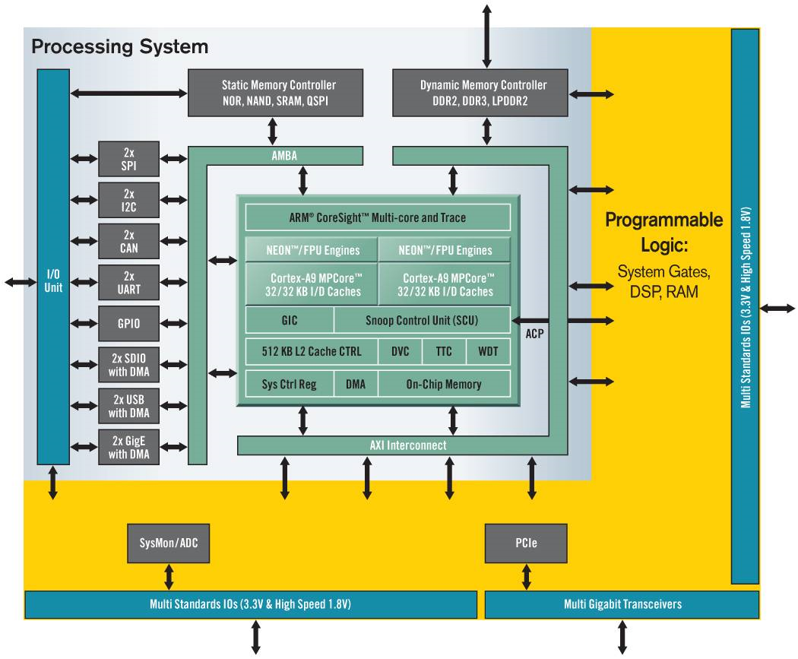
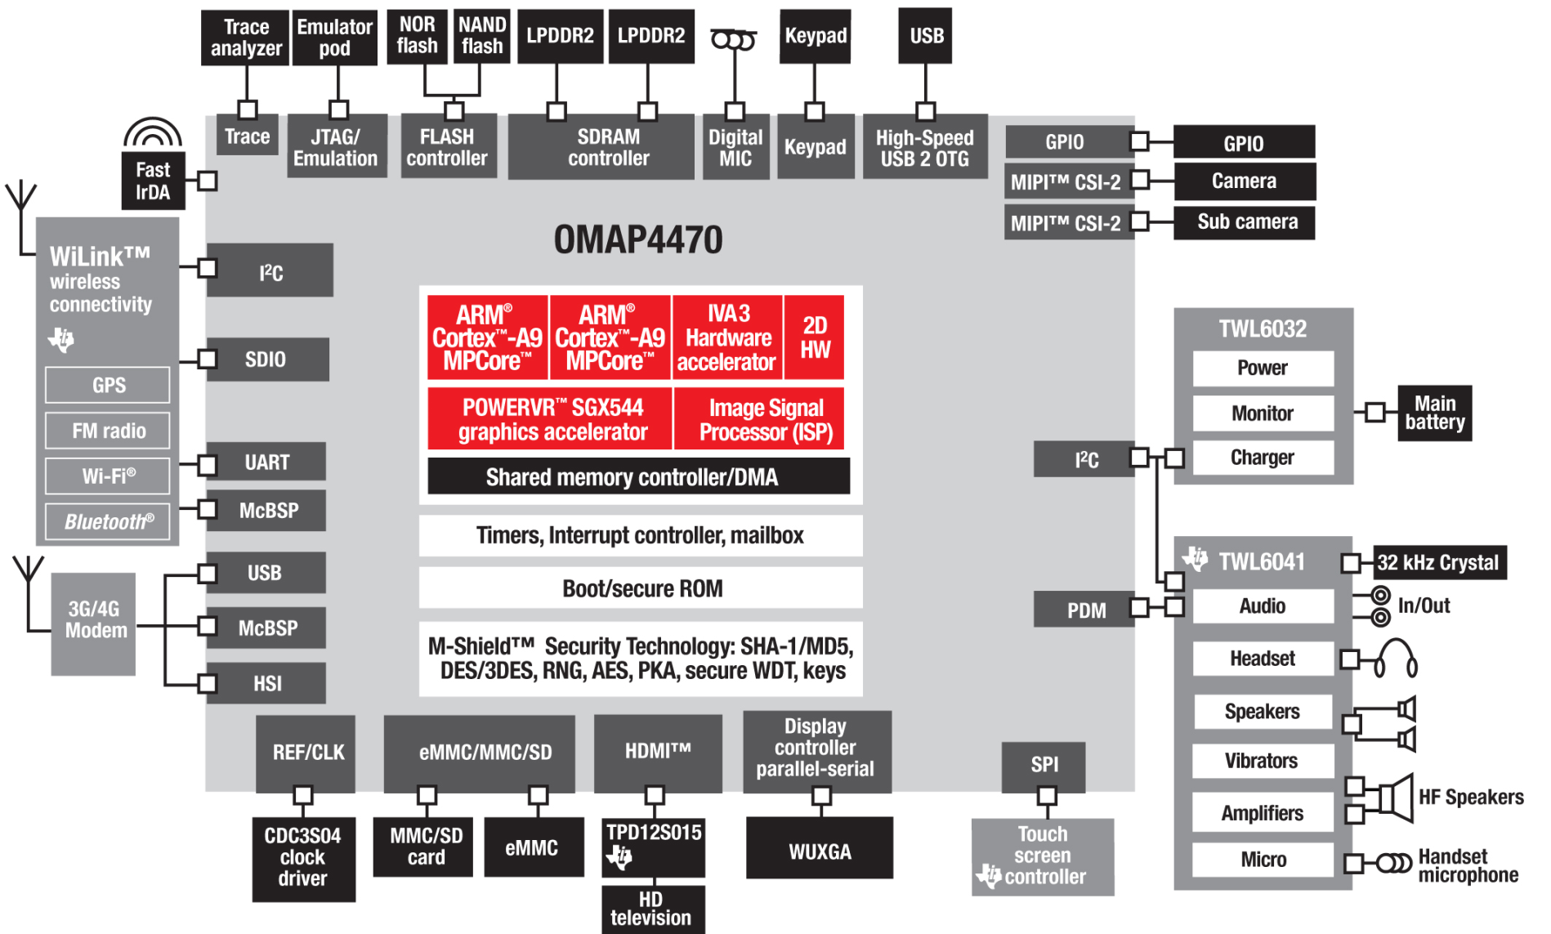
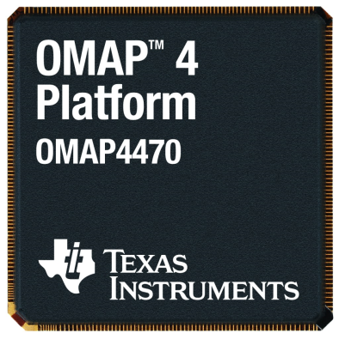
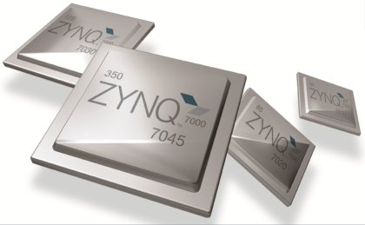
Embedded architectures

Slide 6
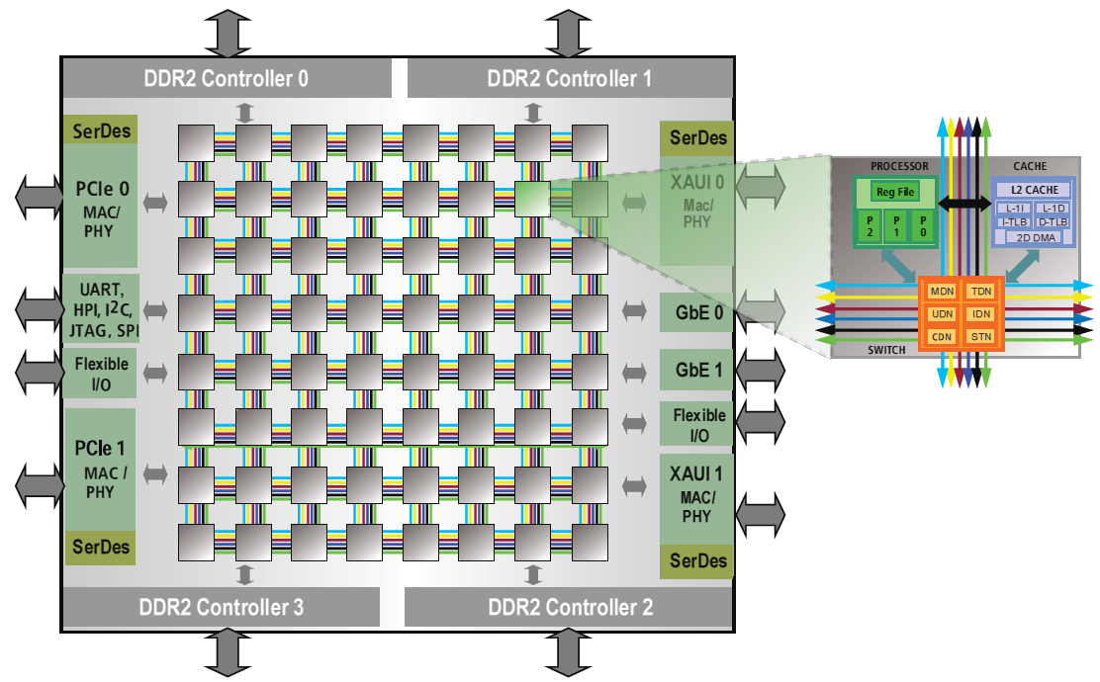
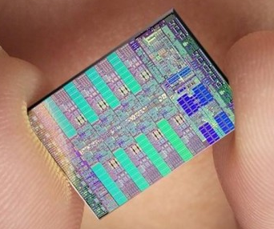
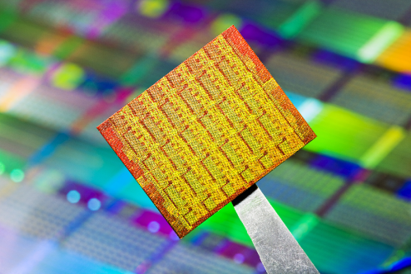
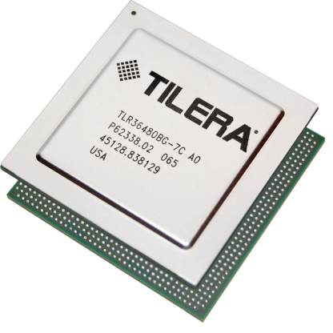
Embedded architectures

Slide 7
Embedded architectures
Our view...
Complex and application-specific
Heterogeneous multicore CPUs, DSPs, GPUs...
Non-uniform memory, non-contiguous, scratchpads
Non-standard hardware
Complex interconnect
Tight domain restrictions
Real-Time
Safety-Critical
Power and resource constraints
Reliability, lifespan

Slide 8
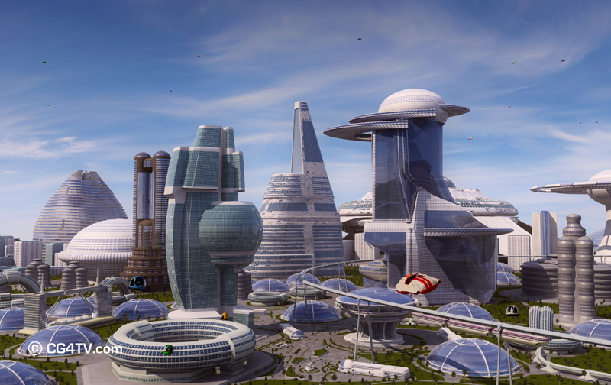
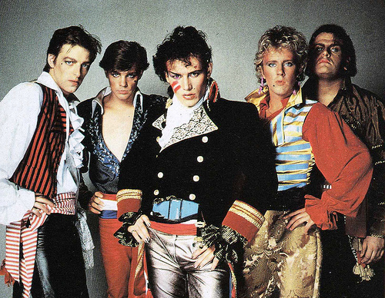
The Programming Gap
Modern embedded architectures are complex
But most programming languages are still based in the 1980s
Single core / SMP
Single uniform address space
Universal communications, caching and coherence
Universally-available services

Slide 9
Outline
Standard APIs
Modelling
Variability
Programming Models
The Future and Big Data

Slide 10
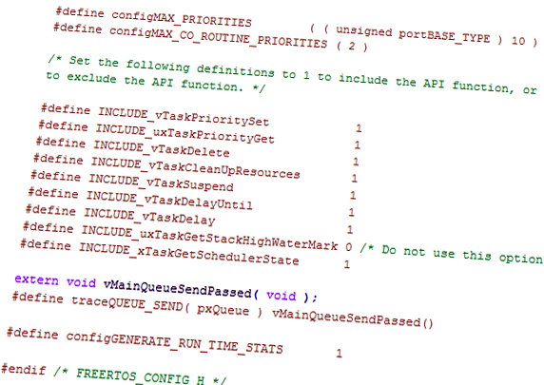
Standard APIs for heterogeneous multicore
Standard APIs
Modelling
Variability
Programming Models
The Future

Slide 11
The MCA APIs
Proposed by the Multicore Association
Industry group founded in 2005 for establishing a set of APIs for multicore technologies
Widely seen as an important contributor to multicore programming practice
The proposed APIs:
Communications
MCAPI
Resource management
MRAPI
Task management
MTAPI

Slide 12
Example: MCAPI
Intended de facto industry standard for inter-core, "on-chip" communications
Message-passing API, like MPI, CORBA etc.
But unlike these, it is very lightweight!
High throughput, tiny memory footprint, low latency
Spans multiple layers of heterogeneity
Core, ISA, OS, language...
But not for large distributed clusters
Notes:
Doesn’t include clever routing
Nodes don’t move
Communications are assumed to be inherently reliable

Slide 13
Other APIs
There are many similar systems
MPI
GASNet
CORBA
OpenMP
These all must work within the semantics of existing languages
Can therefore be limited
Use of memory is very hard
We still don’t know if the system will work
How can we provide extra information outside of the language?

Slide 14
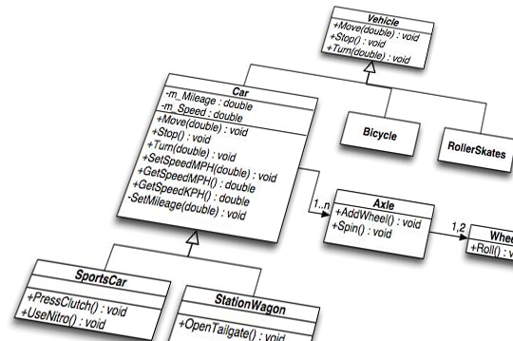
Modelling
Standard APIs
Modelling
Variability
Programming Models
The Future

Slide 15
I know... I know...
Model-driven development
A controlled way of adding extra information during the development of a system
Allows the integration of tools and techniques into existing toolflows
Important for industry

Slide 16
The MADES project
Tools integrated through Epsilon model transformations

Slide 17
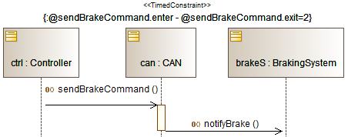
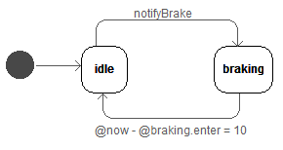
MADES – Verification

Slide 18
The MADES project
So MADES let us target heterogeneous distributed systems
But static ones

Slide 19
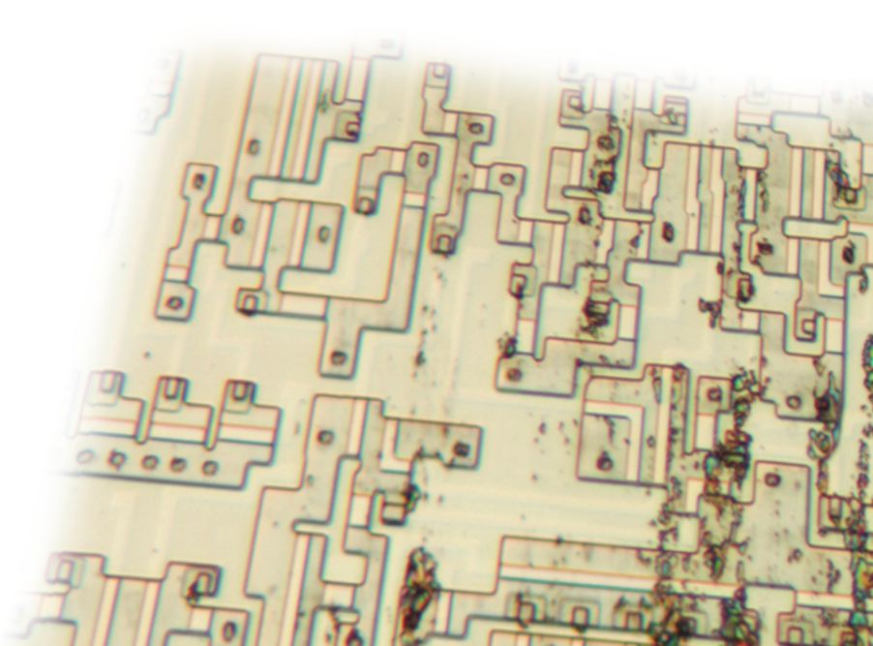
Variability
Standard APIs
Modelling
Variability
Programming Models
The Future

Slide 20
Variability?
So embedded systems are hard – well on top of this, we have variability!
Manufacturing variability
~22% DRAM write power
~15% DRAM idle power
At 50nm a generation of performance improvement is lost - Intel
Run-time variability
Temperature
Load
Degradation
Faults
Designs need to respond to this

Slide 21
The ToucHMore Project
Using Model-Driven Engineering to enable variability-awareness:
Applications
OS/runtime
Hardware mappings
Empower the developer to design to cope with variability
Supported by a user-customisable, variability-aware runtime
All in an industrially-applicable way

Slide 22
The ToucHMore Project
Cluster-based, tiled NoC
Clusters contain multiple heterogeneous CPUs and DSPs
Non-uniform memory

Slide 23
ToucHMore basic overview

Slide 24
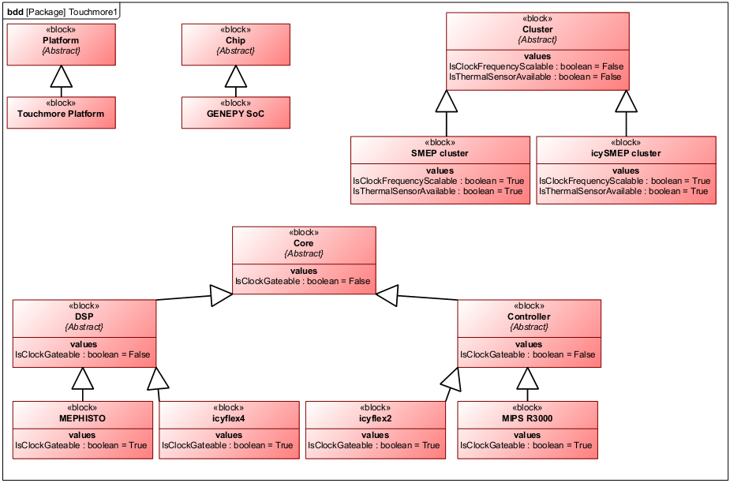
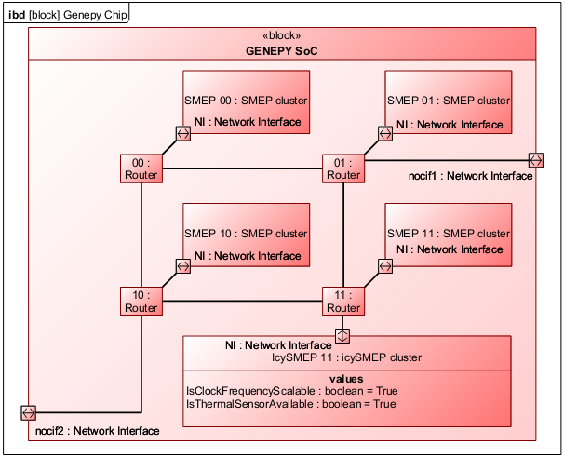
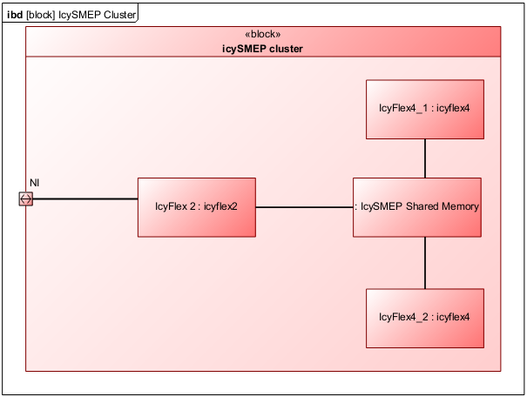
Modelling
Hardware modelling in SysML

Slide 25
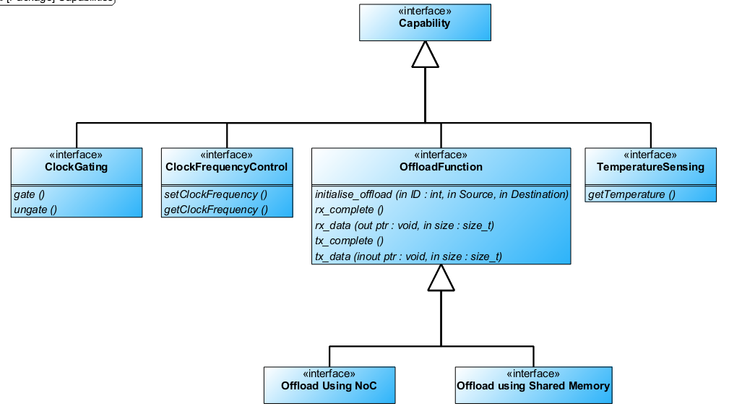
Modelling

Slide 26
Variability features
Variability parameters
Architectural details
Layout
Core frequency scalability and range
Core voltage scalability and range
Clock gating capability
Monitoring capabilities (power, delay)
Measurable parameters (designed, actual, current)
Frequencies
Leakage power (cores and memories)
Dynamic power (cores and memories)
Battery / power state
Critical path delay
Communications latency / bandwidth
Memory latency / bandwidth

Slide 27
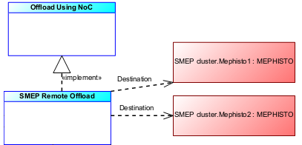
Modelling
Allocation modelling

Slide 28
ToucHMore API
We define a ToucHMore API
Provides a consistent set of services for embedded systems – language and OS neutral
Uses MCAPI and MRAPI
Tasking
Variability parameters

Slide 29
Offloading
Offloadable units provide controllable parallelism
@Offload for coarse-grained parallelism
@Parallel for fine-grained
Information for where to offload from the model
Toolchain generates code for using DMA, activating the target DSP etc.
@Offload(id = 24)
public static void sum_data(@In short[] data, @Out int[] result) {
int sum = 0;
for(int i = 0; i < data.length; i++) {
sum += data[i];
}
result[0] = sum;
}

Slide 30
Complete tool flow
Notes:
Compilettes not included here

Slide 31
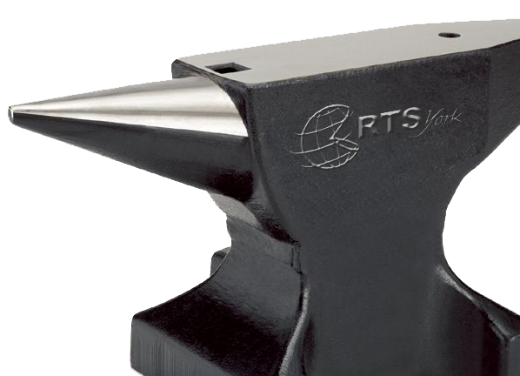
Programming Models
Standard APIs
Modelling
Variability
Programming Models
The Future

Slide 32
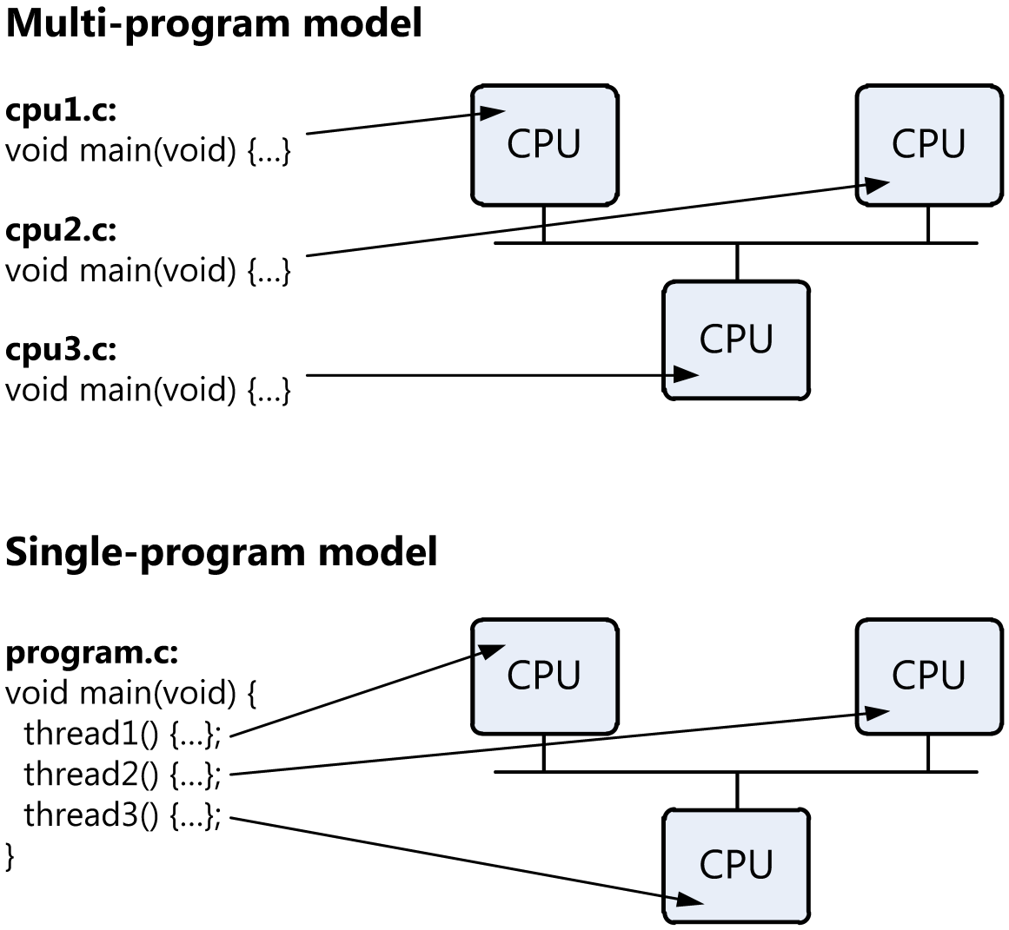
Programming Models
Many existing approaches require a multi-program model
A single-program model may be better

Slide 33
Fixing the Programming Gap
Hacks
Work around the problem
Custom tools, affinities, assembly, link scripts
Make a new language (or subset)
Change the programming model
OpenMP, Sequoia, StreamC, UPC...
Code reuse, developer reuse, tools
Introduce frameworks / middleware / virtualisation
Translate the programming model
Distributed OSs, CORBA
Footprint, hardware support, unpredictability

Slide 34
Compile-Time Virtualisation
Introduces a compile-only Virtual Platform
Notes:
Idealised view of the hardware
Language agnostic
Unlike runtime systems, virtualisation mappings influenced by the programmer
Hardware features exported up to scope of the source code to allow their explicit use
Code is insulated from hardware changes, same code supports any architecture

Slide 35
System Model
Limit run-time flexibility to allow a low-overhead solution
Developer defines a set of static instances (threads)
Static instances stay on the same CPU for the life of the system
Dynamic instances must only communicate with static instances, or dynamics on the same CPU

Slide 36
Overheads
Each node has a minimal microkernel
Suitable for real-time WCET analysis

Slide 37
Integration with modelling

Slide 38
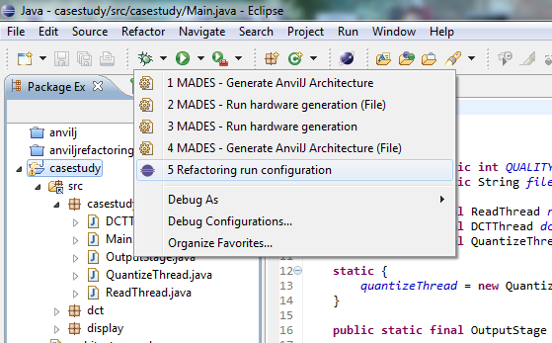
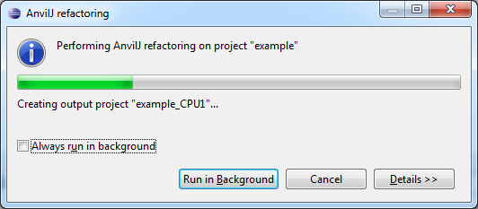
Integration with modelling
Models exported as XMI using Epsilon

Slide 39
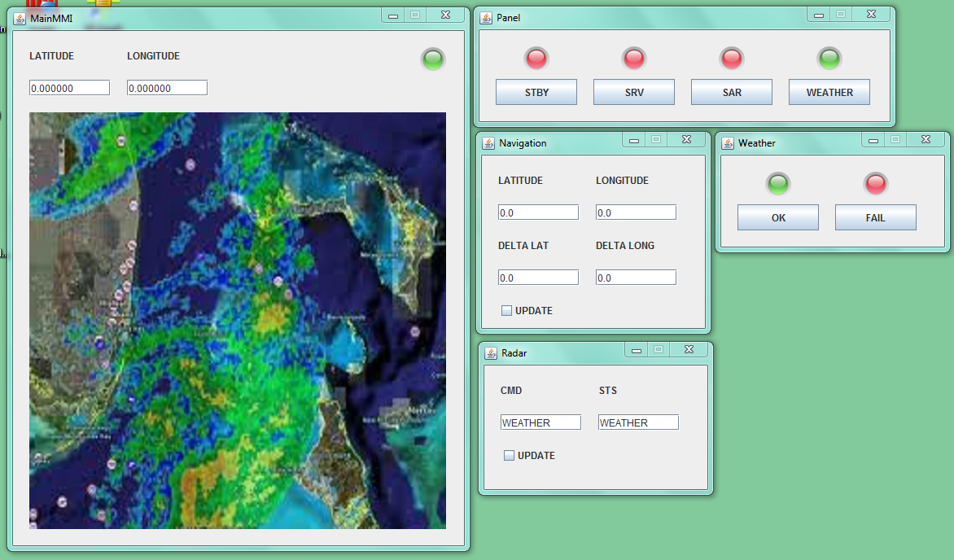
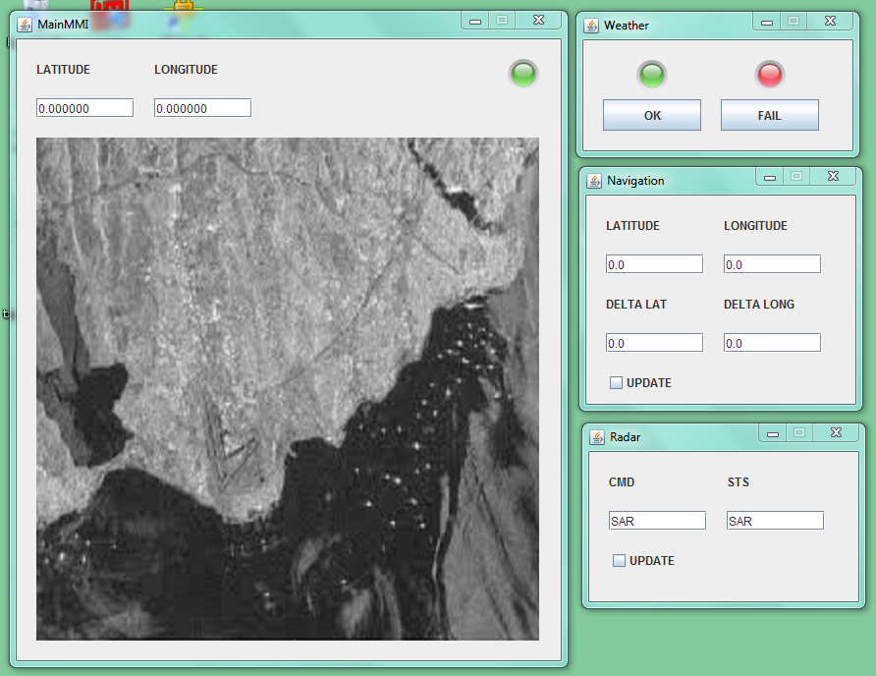
CTV in action
Computer 1
Computer 2
Wireless Network

Slide 40
BIG DATA!
Standard APIs
Modelling
Variability
Programming Models
The Future

Slide 41
Big Data
By 2016, total traffic will be 4x what it was in 2011
30bn items of content shared on Facebook per month
92% of the world's data was produced in the last 2 years
A four-engine jumbo jet can create 640 TB per Atlantic crossing
There are >25,000 flights a day

Slide 42
Big Data
Big Data is a collection of data sets so large and complex that it becomes difficult to process using on-hand database management tools or traditional data processing applications - Wikipedia

Slide 43
The JUNIPER project
Objective:
Create a Real-Time Scalable Java Platform to build high-performance Big Data applications, enabling real-time constraints to be met
Outcomes:
MDE for real-time big data applications
Standard annotations within for Java to support big data
Introduce locality concepts
Enable mapping to parallel and data-streaming architectures
Extensions within the Java VM
to support highly parallel architectures
Java API to allow discovery of underlying platform architecture
Scheduling within the RTOS that support real-time guarantees
Acceleration of Java via hot-spotting and hardware (FPGA) implementation of key components
March 1st 2013

Slide 44
The JUNIPER project

Slide 45
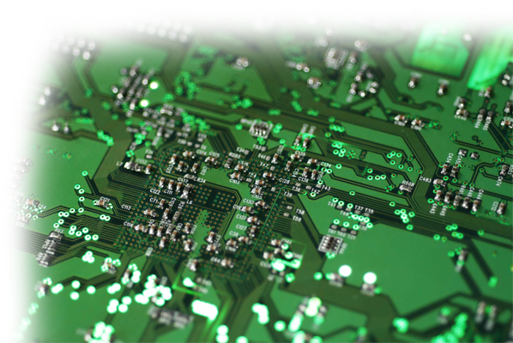
Conclusions

Slide 46
Conclusions
Programming for embedded architectures is challenging
The Programming Gap means the programmer needs to be able to express more concepts than software alone
MDE can help with this
Controlled virtualisation aids the programmer
Variability is a big concern as systems become more heterogeneous
Big data
Requires entirely new approaches

Slide 47
Thanks
RTS Group
www.cs.york.ac.uk/rts
AnvilJ
rtslab.wikispaces.com/AnvilJ
MADES - www.mades-project.org
ToucHMore - www.touchmore-project.eu
JUNIPER - www.juniper-project.org

